Slide 1

Metor Ethernet
Ali MENTEŞ
Platon Bilişim Akademi
1
Notes:
1

Slide 2


Slide 3
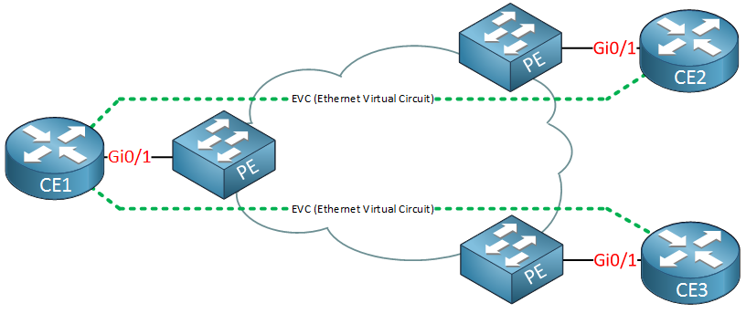
Metor Ethernet Topology
Hidden form User(Enterprise)
Forwards ethernet packets from one
router to other.
(ISP act as a SWITCH)
Ethernet Packet
Ethernet Access Link
UNI(User -Network Interface)
SW only checks MAC form Ethernet fram eor 802.1Q frame
Can vary from 100Mbps 5 Km To 10Gbps 40 Km
Notes:
3

Slide 4
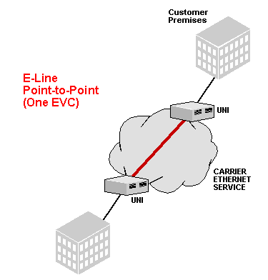
Metor Ethernet Services
Ethernet Line Service (E-Line) Point -To- Point
Two customer premise equipment (CPE) devices can exchange Ethernet frames, similar to a leased line.
Router
Ethernet Virtual Circuit(EVC)
Defines which customer device communicate to which one.
If more than one remote side connected to central side:
Remote sides act as diffeent VLAN and Router port
Configured as VLAN-Routing by subinterfaces.
If multi E-Line connected to a central router each
E-Line should has its own subnet.
Notes:
3

Slide 5
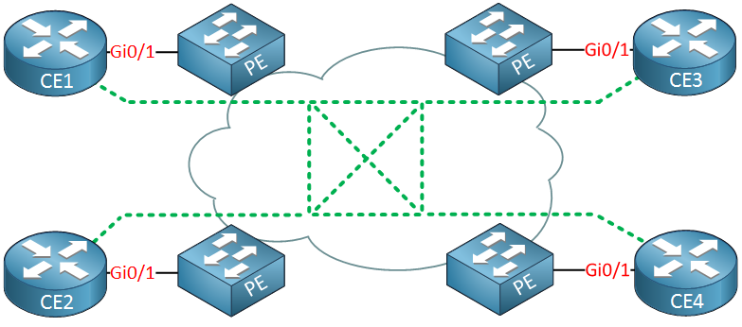
Metro Ethernet Services
Ethernet LAN Service (E-LAN) Full Mesh
This service acts like a LAN, in that all devices can send frames to all other devices.
Allowing all devices to send directly to every other device is simalar to an Ethernet LAN, so the MetroE service is called an Ethernet LAN service, or E-LAN.
Routers R1, R2, R3, and R4 can all send frames directly to each other. They would also all be in the same Layer 3 subnet on the WAN.
For full-mesh case all four router should be in same subnet and all routers sends its ethernet frame directly to related router.
There can be also partial mesh service(E-Tree)
Notes:
3

